Slide 1

SaaS Enablement Engagement Model

Slide 2
Presentation Overview
This is a Basic Engagement Framework
Actual engagements will vary to meet needs
Activities and deliverables listed
Based on Agile Project Management
Assumes new product development
Full product development cycle
Each element of the cycle can stand alone as a spot engagement
How much application development needed?
May require more or less depending on components selected

Slide 3
Engagement Model
Product Definition
Product Design
User Experience Design
Development Sprint 0 to N
Launch V1.0
Maintenance & Operations
Expertise
Technology
Process
Business

Slide 4
Product Definition (2-4 weeks)
Market
Competitive Position
Trends
Features
Customer/User Profile
Strategic Feature Set
Functional Requirements
Product Release Roadmap
Value Chain
Operations
Business Model
Pricing Model
Operations Process
Sales & Marketing Planning
Technology
Value Proposition

Slide 5
Product Design (1-4 weeks)
Necessary Steps | Using a PaaS* | No PaaS
Legacy Application Analysis (optional) | Y | Y
Technology Stack Selection | N | Y
Deployment Platform Selection | N | Y
Application Architecture Design | Y (but reduced) | Y
Infrastructure Architecture Design | N | Y
Hosting Solution Selection | N (or optional) | Y
Third-party Component Selection | Y (but reduced) | Y
Product Backlog Development | Y | Y
*PaaS = Platform as a Service (SaaSGrid, Force.com, etc.)
Using a PaaS streamlines and provides solutions for many of the technical decisions and functionality components of the new SaaS product

Slide 6
User Experience Design
User Experience (UX) = SUM of all user interaction, perception, and interpretation of your product
Process
Process Flow
Target Market
Site Marketing Specifications & Plans
Navigation
User
User Stories
Interface Development
Prototypes
Interface
User Interface Design
Interaction Expectations
UX & Usability Specifications
Deliverables
Deliverables

Slide 7
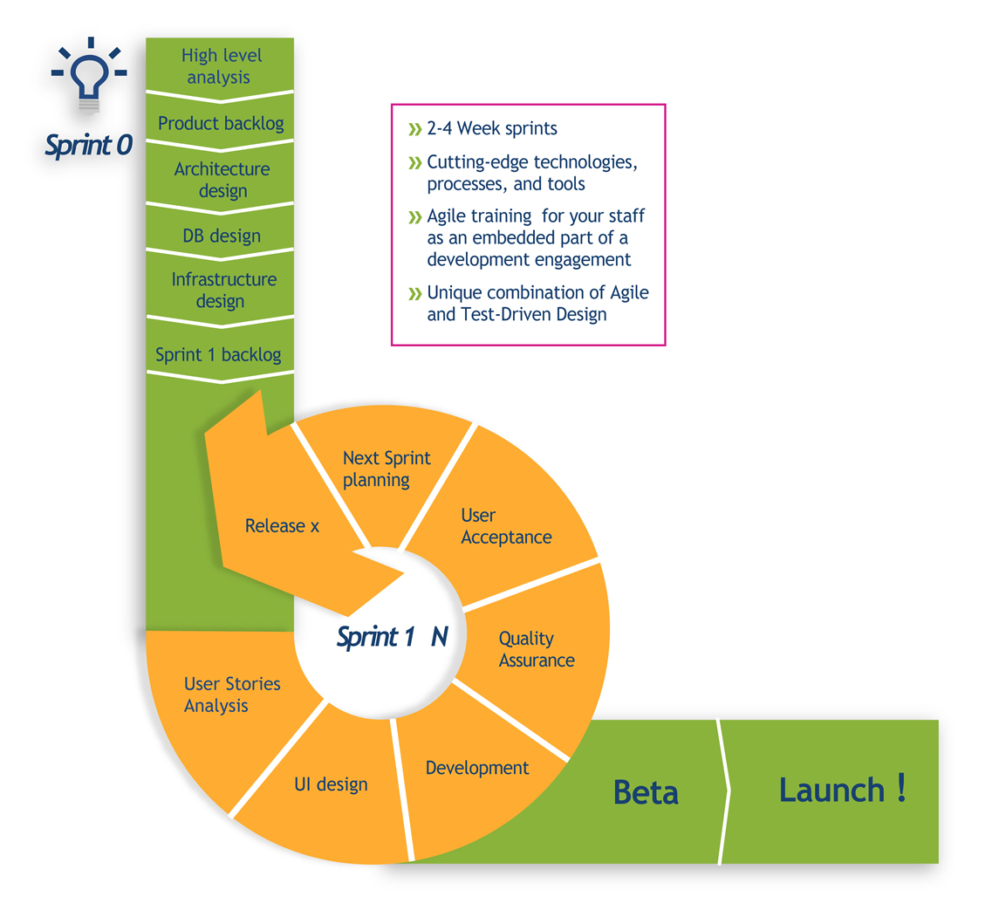
V1.0 Development (3-9 months)
Sprint 0 - Development Kickoff
Sprint 1 to N - V1.0 Development

Slide 8
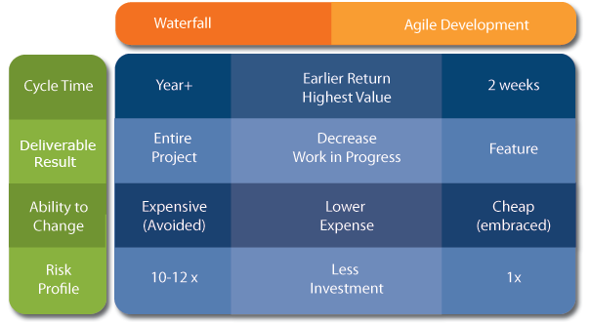
Sprint 0 - Development Kickoff
Database Schema Outline
Dev/Test Environment Setup
Sprint 1 Backlog Development
Sprint 1 User Stories Development
Why Agile?

Slide 9
Sprint 1 to N - V1.0 Development
User Stories Analysis
User Interface Design
Sprint Backlog Development
User Story Testing
Sprint Backlog QA and Showcase (optional)
Sprint Backlog Customer Acceptance
Sprint Review
Next Sprint Planning
Next Sprint User Stories Development
Product Release (optional)

Slide 10
V1.0 Launch (2-3 weeks)
Production Environment Shakedown
Full Regression Test on Production Environment
Beta (optional)
Final Product Revisions
Go-live Support
Rapid Issue Response
Customer Service Support

Slide 11
Continuing Development: Version 2 to N
Release Management (optional)
Sprints
Sprint 0
Sprint 1 – N
Launch
Development Kickoff
V 1.0
Version 2 – N
Sprints

Slide 12
Operations & Maintenance (ongoing)
Application Maintenance
Customer Service Support
Infrastructure Management
Customer Service
App Maintenance
Infrastructure Management

Slide 13
Questions?
?

Slide 14
Jeremy Beck VP of Business Development 408.404.3897 x301 jbeck@sciodev.com
http://www.sciodev.com

